Slide 1
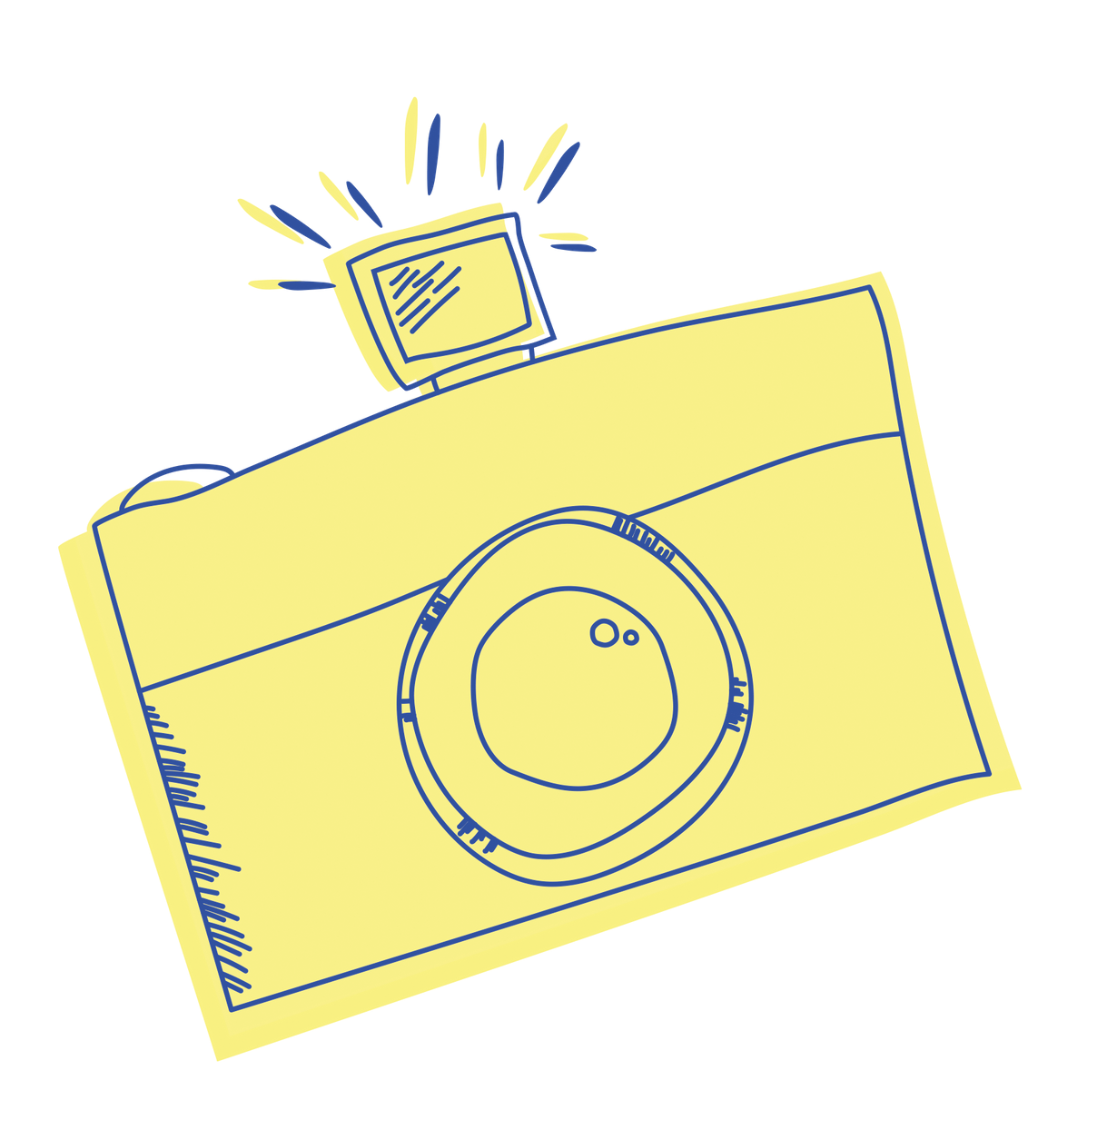
MODULE 4
Exposure
Kids Photography Camp | By Your Photo Studio

Slide 2
Exposure
ISO
ISO stands for International Organization for Standardization. This term is used to describe your camera’s sensitivity to light.
When purchasing film you can choose the film speed or ISO. On digital cameras you can adjust the IS0. The lowest ISO setting on most digital cameras is 100 ISO which has the least sensitivity to light.
Many digital cameras today can go up to 6400 ISO or higher. Higher ISO settings are used in low light situations. The downside of increasing your ISO is that your images will have more “noise” (or artifacts) in the image.
Kids Photography Camp | By Your Photo Studio

Slide 3
ISO
Let's Take a Closer Look
100
200
400
800
1600+
Lower ISO - Darker
Higher ISO - Brighter
Kids Photography Camp | By Your Photo Studio

Slide 4
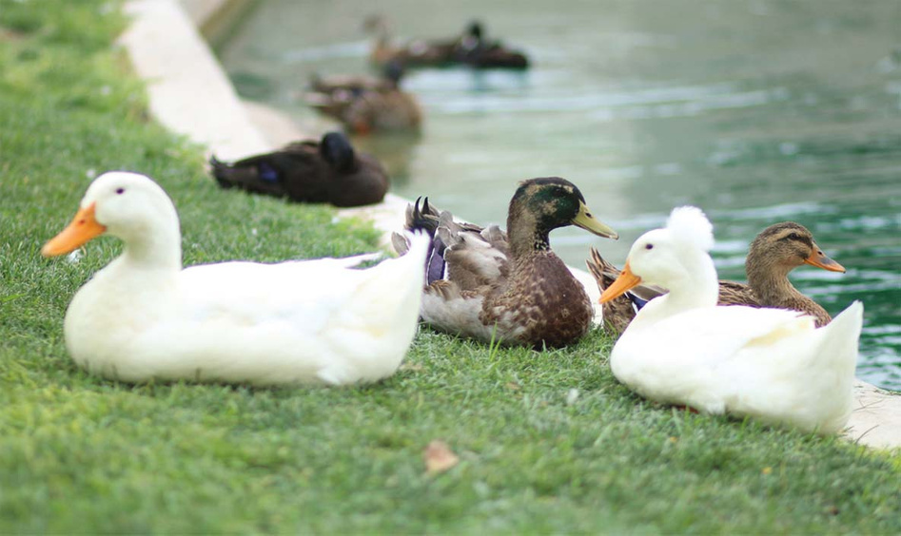
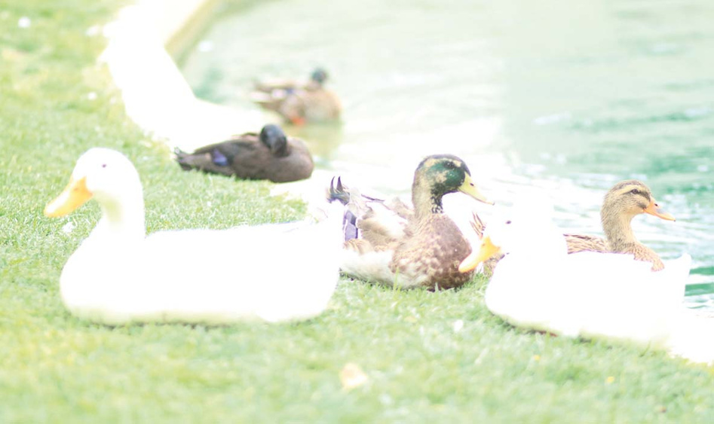
HIGHER ISO
ISO 400
More sensitive to light
More noise (artifacts)
Use indoors, outdoors in the evening and at night
.
ISO 1600
LOWER ISO
Sharper images (no noise)
Less light sensitivity
Use a lower ISO outdoors on a sunny day.
Kids Photography Camp | By Your Photo Studio

Slide 5
Exposure
APERTURE
Your camera’s aperture controls how much the opening inside the lens opens and closes. By adjusting and managing your aperture using f-stops, you can control the amount of light that enters your camera.
The f-stop is a fraction, so a lower f-stop such as 3.5 (1/3.5) means the opening is wider, while a higher number such as 28 (1/28) means the opening is very small and less light will enter the camera.
Kids Photography Camp | By Your Photo Studio

Slide 6
APERTURE
Let's Take a Closer Look
f/2.8
f/4
f/5.6
f/8
f/11
f/16
f/22
Higher Aperture
Lower Aperture
Kids Photography Camp | By Your Photo Studio

Slide 7
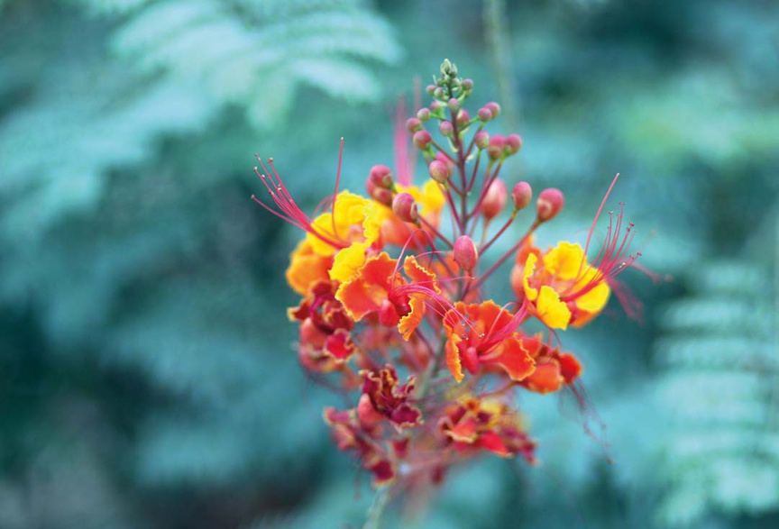
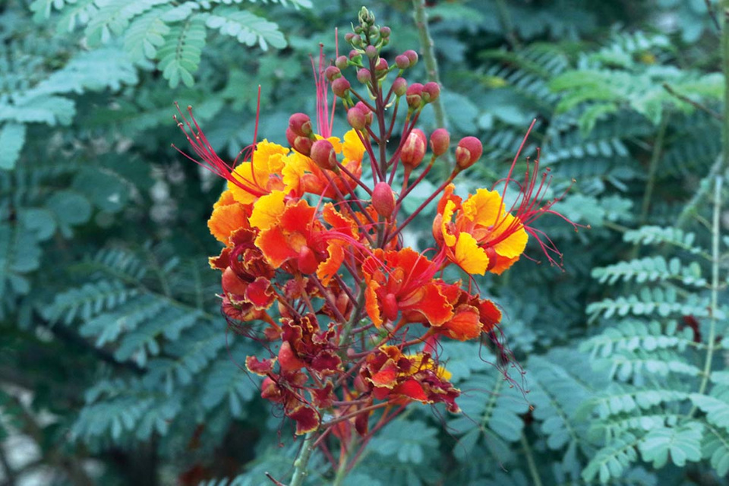
HIGHER APERTURE
f/1.8
Brighter exposures
Use when in low light or when you want to blur motion
.
f/10
HIGHER APERTURE
Brighter exposures, more artistic
Less in focus, narrow depth of field
Use to achieve a nice blurry background
Kids Photography Camp | By Your Photo Studio

Slide 8
Exposure
SHUTTER SPEED
Your shutter speed is how long it takes for your camera’s shutter to open and close. This affects how much light hits the sensor.
A slow shutter speed lets more light in and is often used in darker scenarios. A fast shutter speed lets less light in and can be used in scenarios where more light is available. Fast shutter speeds should also be used to capture moving objects.
Kids Photography Camp | By Your Photo Studio

Slide 9
SHUTTER SPEED
Let's Take a Closer Look
1/60
1/125
1/250
1/500
1/1000
Slower
Faster
Kids Photography Camp | By Your Photo Studio

Slide 10
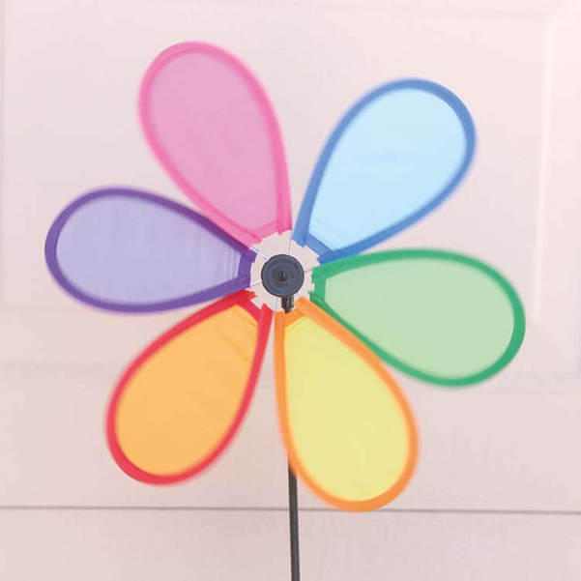
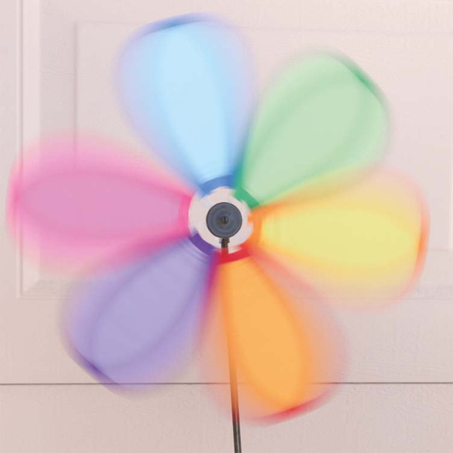
SLOWER SHUTTER SPEED
1/500
Brighter exposure in low light
More blur
Use when in low light or when you want to blur motion
.
1/85
FASTER SHUTTER SPEED
Less blur, sharper images
Darker exposure in low light
Use outdoors on sunny days or to reduce motion blur on moving subjects
Kids Photography Camp | By Your Photo Studio

Slide 11
Let's Review
ISO
SHUTTER SPEED
Your camera sensor's sensitivity to light.
How fast the camera on the shutter opens and closes..
APERTURE
Controls how much the shutter opens inside the lens.
Basic Dgiital Photography for Kids | By You Photo Studio
Kids Photography Camp | By Your Photo Studio

